Slide 1
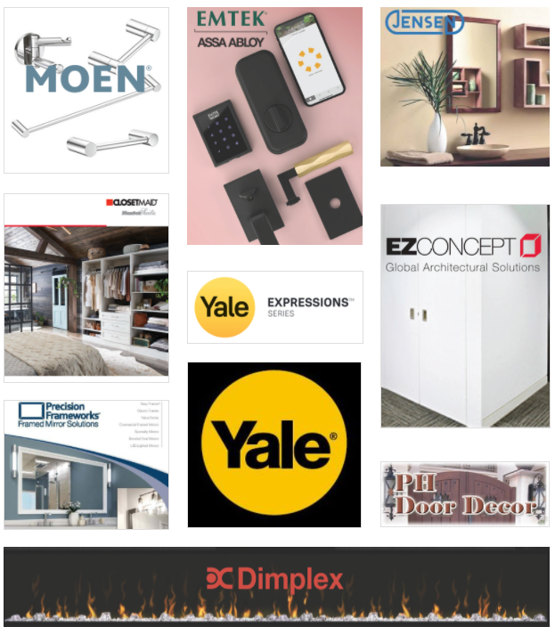
OSM PROUDLY REPRESENTS THESE FINE MANUFACTURERS:

Slide 2
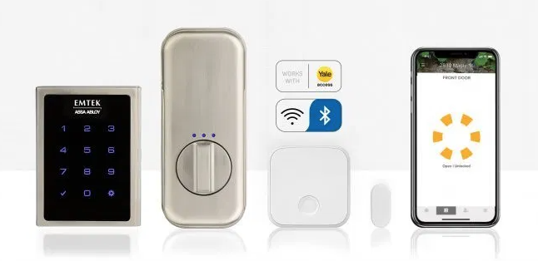
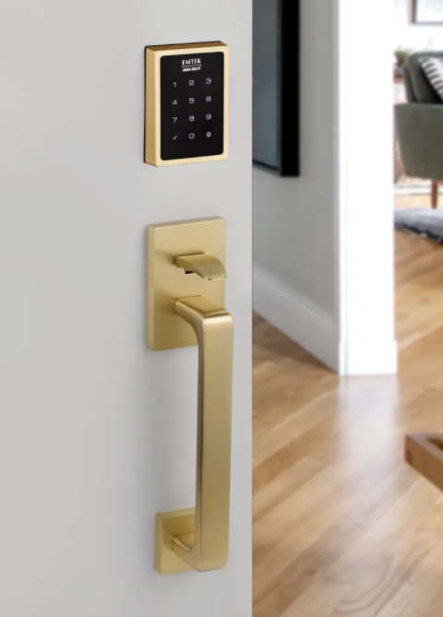
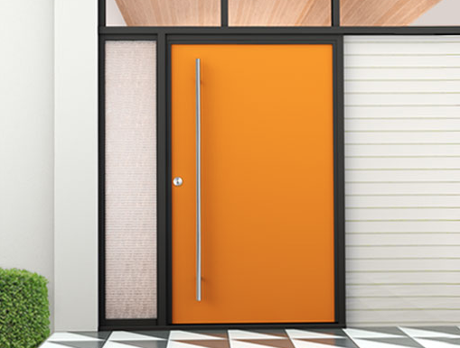
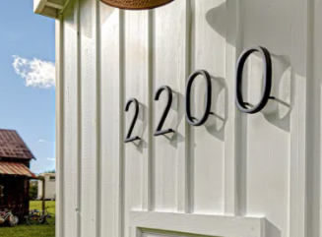
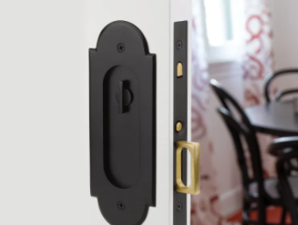
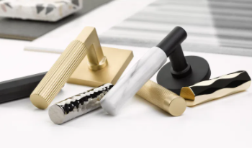
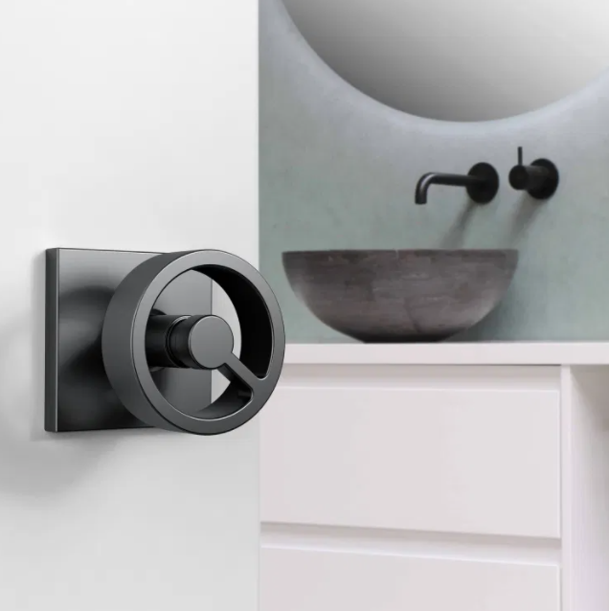
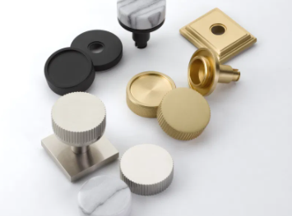
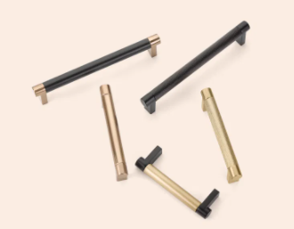
Emtek
Assembled In Los Angeles
Design Focused
Customizable
Quick Leadtime
Variety for Products
Notes:
1) Owned by Assa Abloy one of the largest lock manufacturers in the world
2)

Slide 3
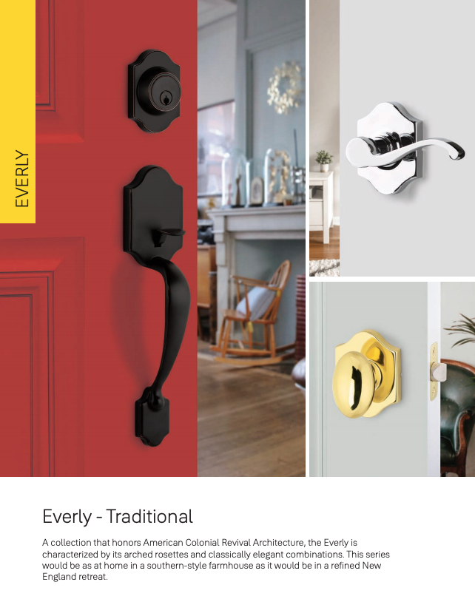
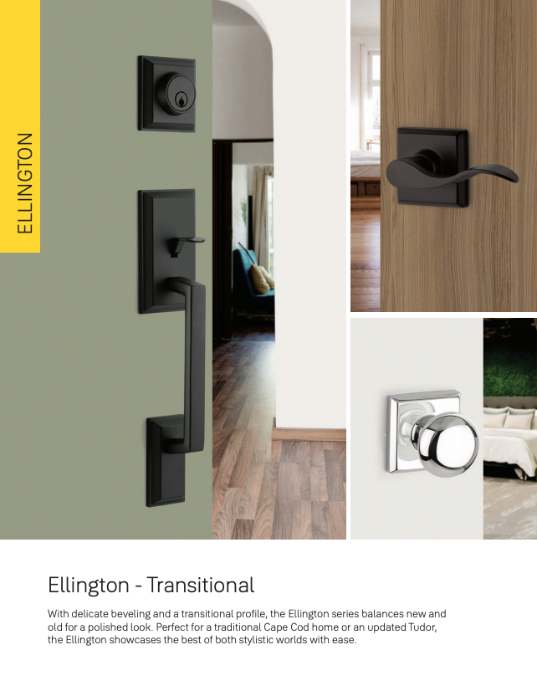
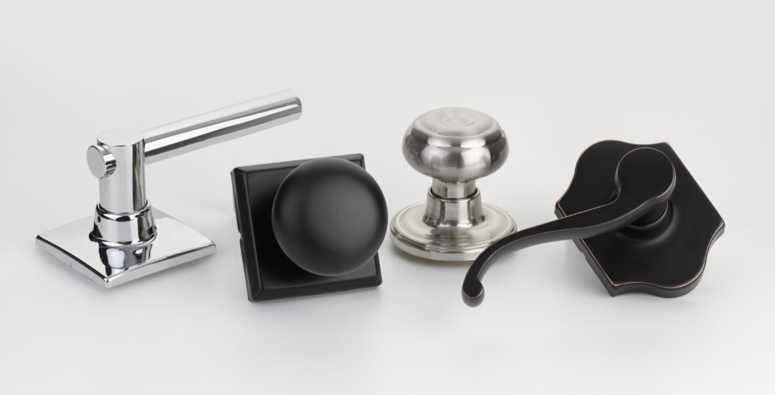
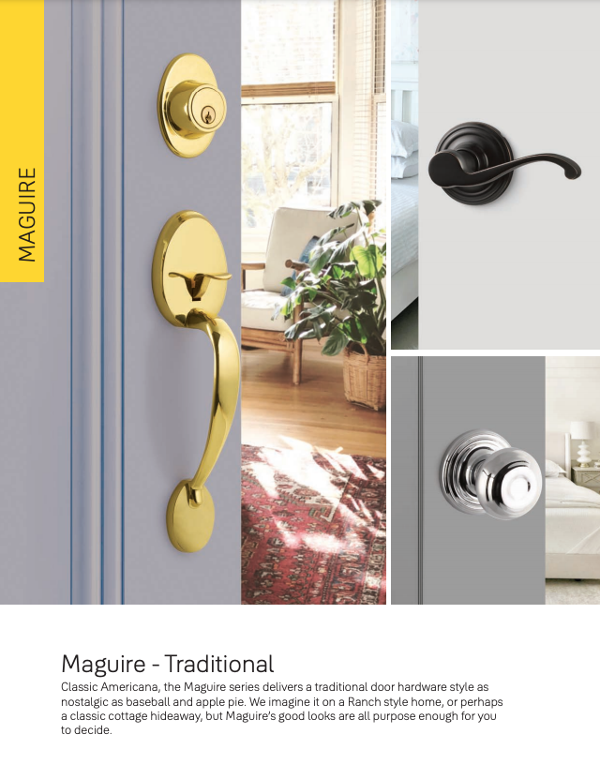
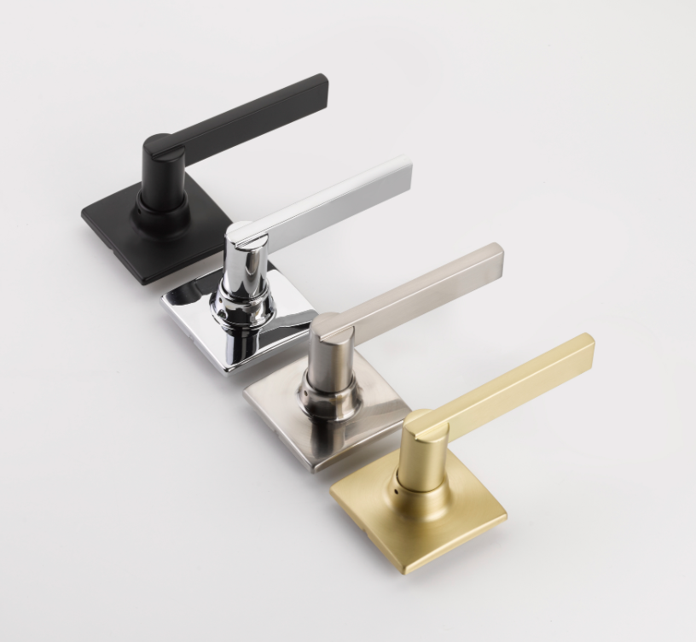
Yale Expressions
Local Inventory
Variety of Finishes
Variety of Styles
Quick Leadtime
Competitively Priced
Notes:
1)Schlage or Kwikset Key Way
2) Black and Satin Brass at price point
3)

Slide 4
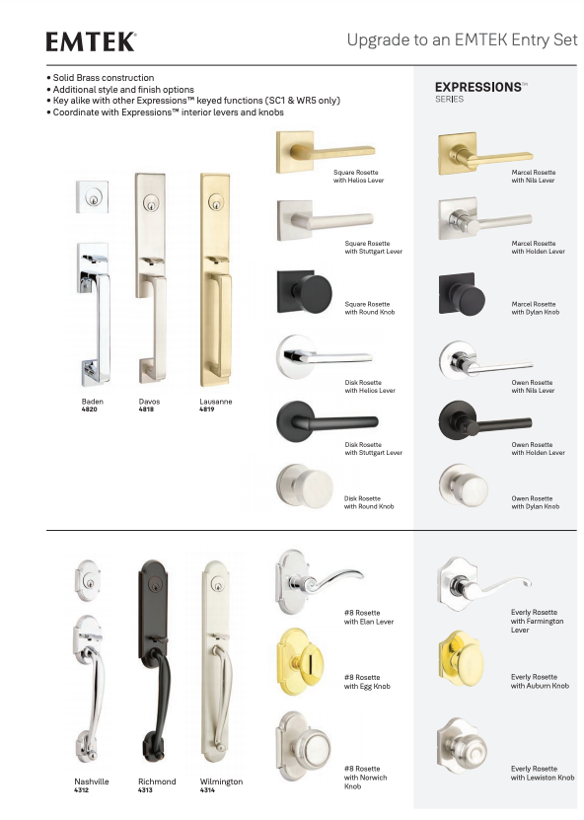
Emtek and Yale Expressions
Local Inventory
Ordered Together
Key alike
Coordinating Finishes & Styles

Slide 5
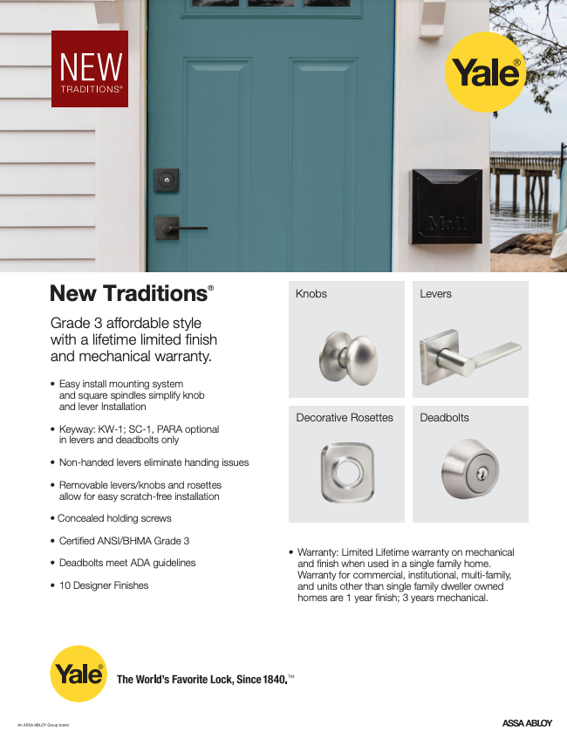
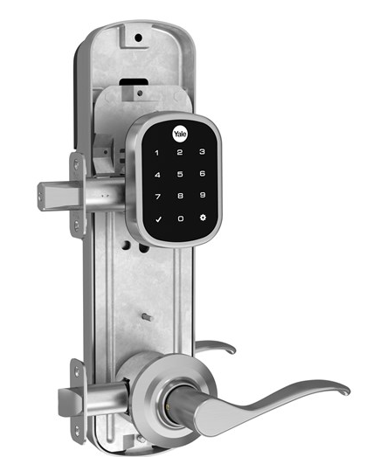
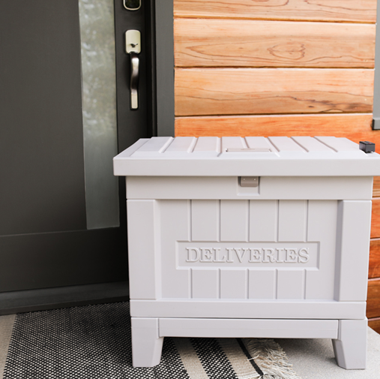
Yale Residential
Single/Multifamily Solution
UL Rated Latches
Grade 2 & 3
Smart Delivery Box
Notes:
1)Electronic Interconnect

Slide 6
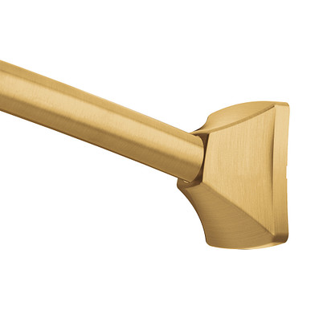
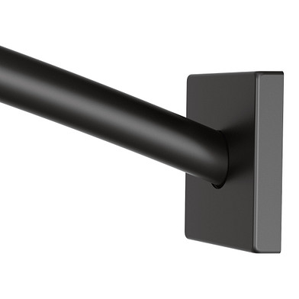
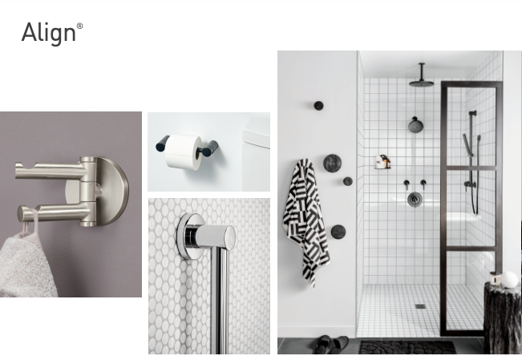
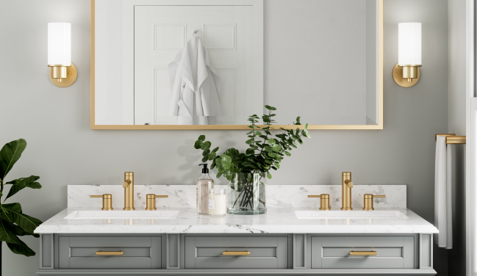
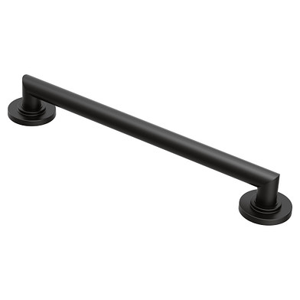
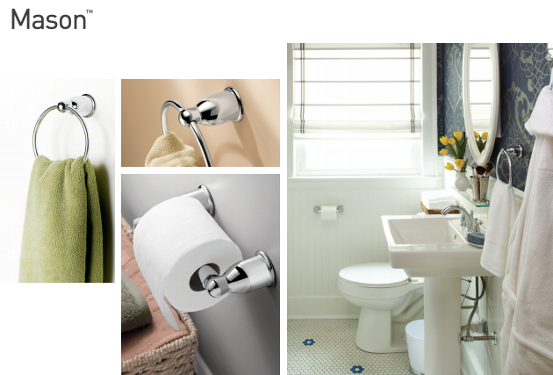
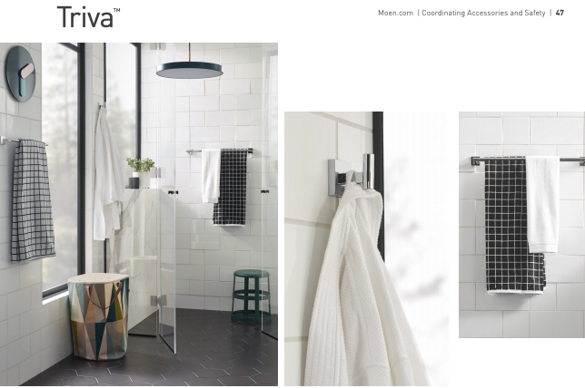
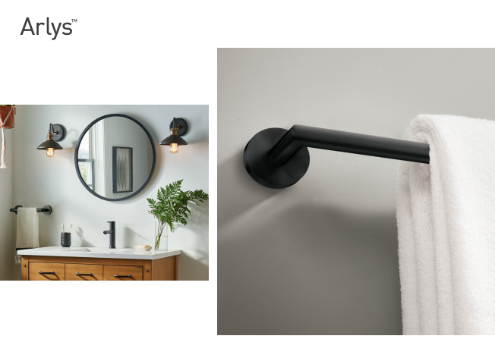
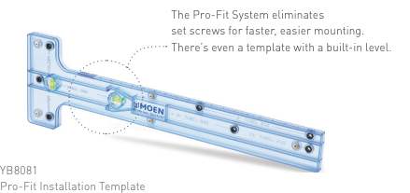
Moen Accessories
Faucet Matching
Stand Alone
Curved Shower Rods
Decorative Grab Bars
Lighting

Slide 7
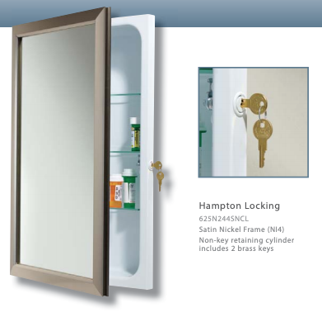
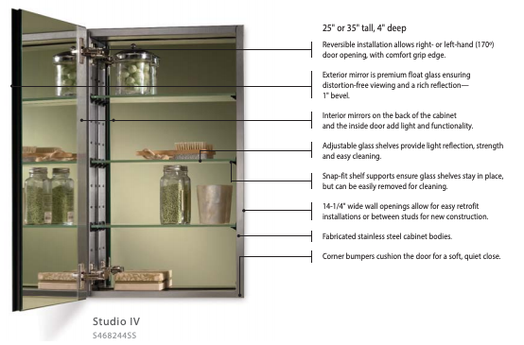
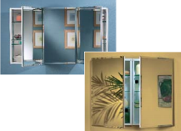
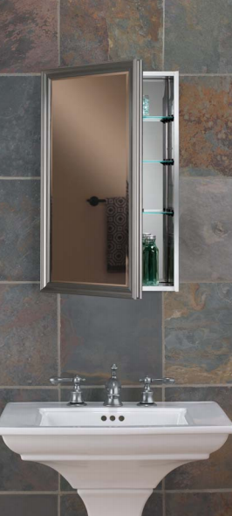
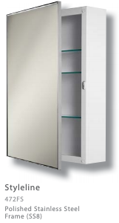
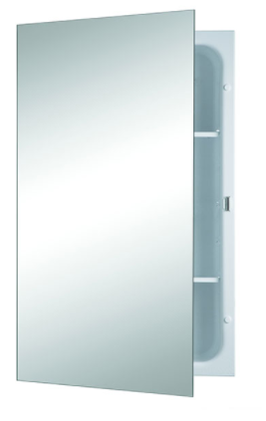
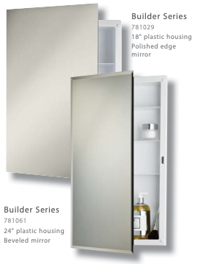
Jensen
Good, Better, Best
Stainless Steel, Metal, & Plastic bodies
Framed, Polished,& Beveled Edged Mirrors

Slide 8
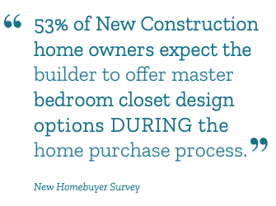
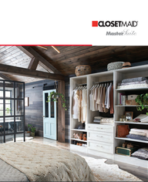
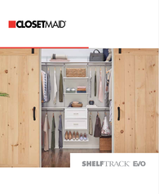
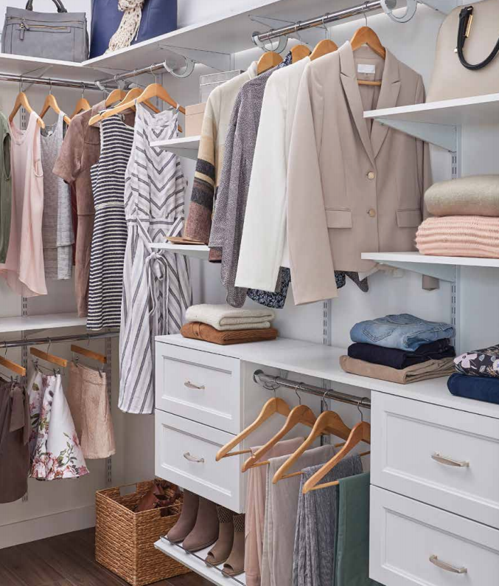
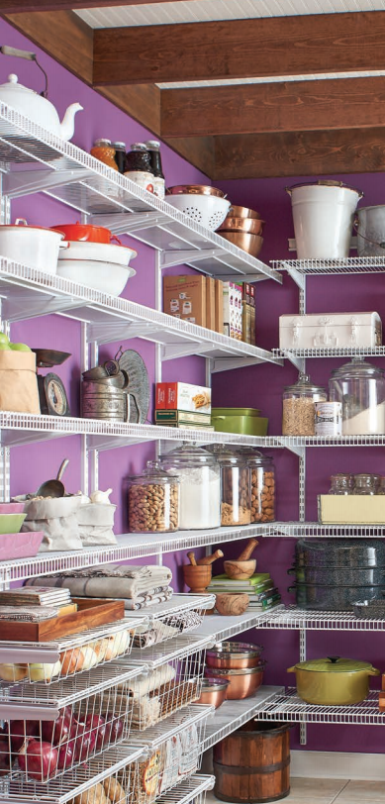
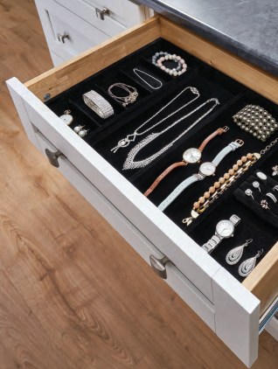
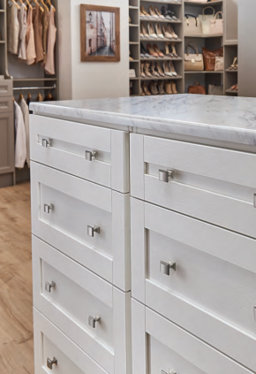
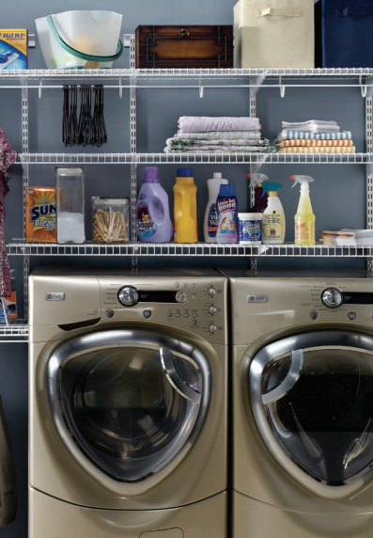
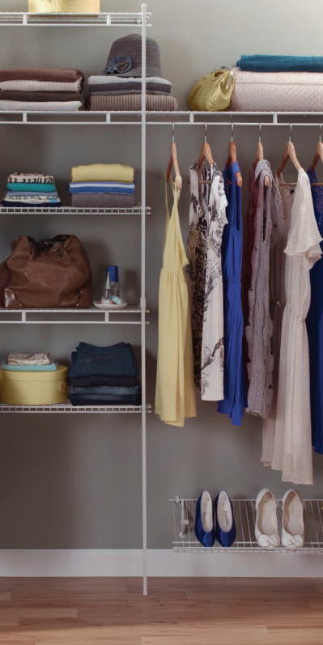
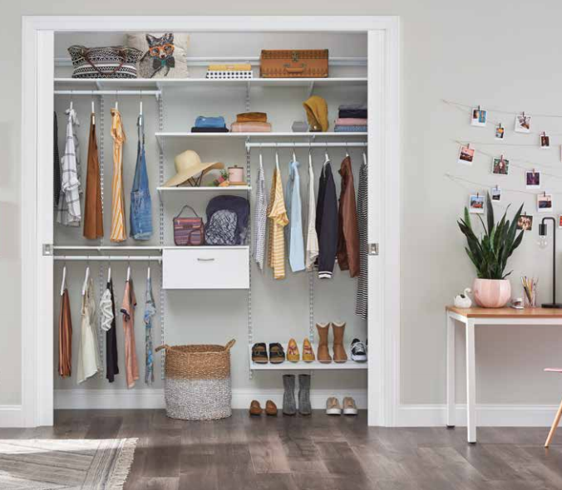
Closetmaid
Good, Better, Best
11 MasterSuite finishes
Evo Adjustability
Design Software

Slide 9
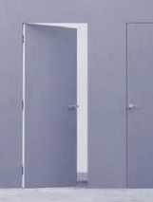
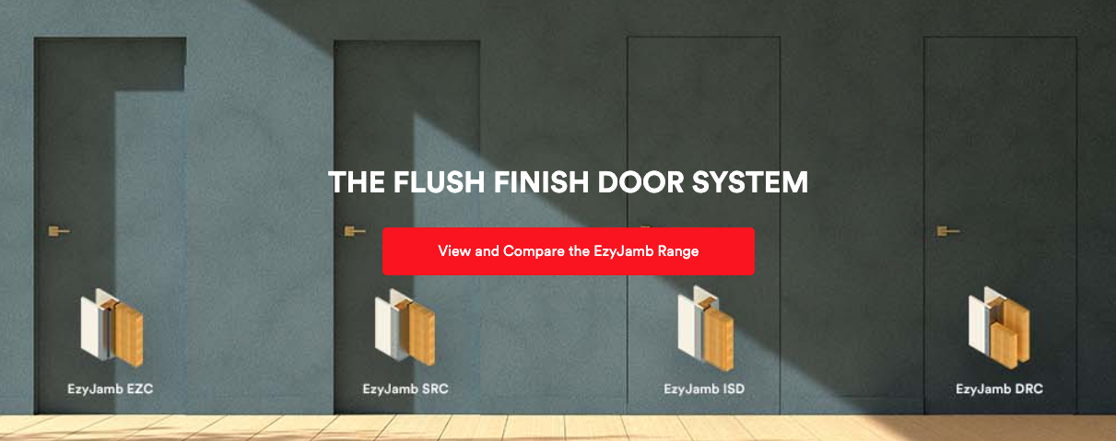
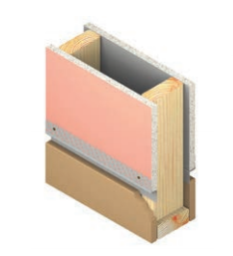
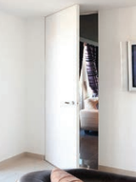
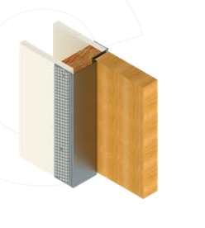
Ez Concept
Contemporary & Clean
Fire Rated
Concealed Hinges

Slide 10
Precision Frameworks
LED Mirrors
Specialty Mirrors
Framed Mirrors

Slide 11
Dimplex
XLF-50”,60”,74”, & 100”
XLF installs into 2x6 or 2x4
Optimyst- Water Vapor
Revillusion-Concrete or Herringbone back

Slide 12
Dimplex
New Products
Ignite XL Bold
Multi-fire SL

Slide 13
PH Door Decor
Decorative Garage Door, Gate, Shutter & Entry Door Hardware.
Clavos
Straps Hinges
Grills
Speakeasys

